Slide 1
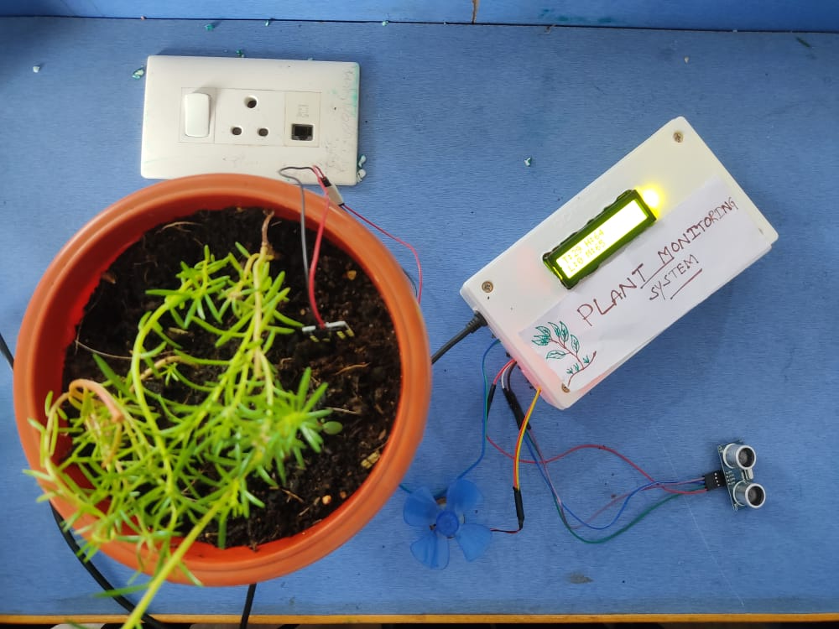
Slide 1

Slide 2
INTRODUCTION
This project deals about the plant monitoring mechanism which gives information about the Temperature, Humidity , Moisture and Water Level of the tank using Arduino UNO.
This can be done by using various sensors like :
DHT11 : Temperature and Humidity Sensor
Moisture Sensor
Ultra Sonic Sensor: Water level Sensor
This will be enhancing the growth of the Plant

Slide 3
COMPONENTS USED
Arduino Uno
DHT11
Ultrasonic Sonic Sensor
Soil Moisture Sensor
Motor
LCD Display
Motor
Arduino IDE Software
Wifi- Module

Slide 4
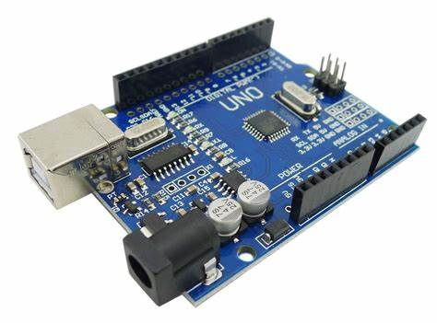
ARDUINO UNO

Slide 5
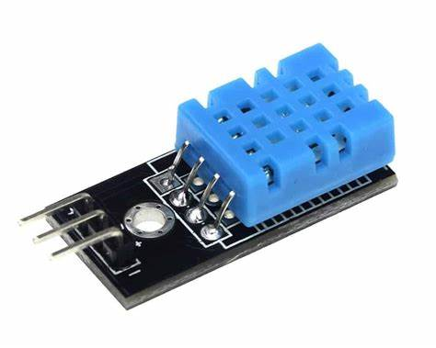
DHT11

Slide 6
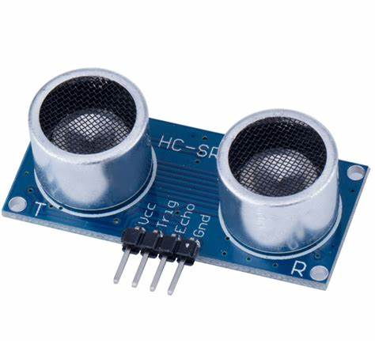
Ultra Sonic Sensor

Slide 7
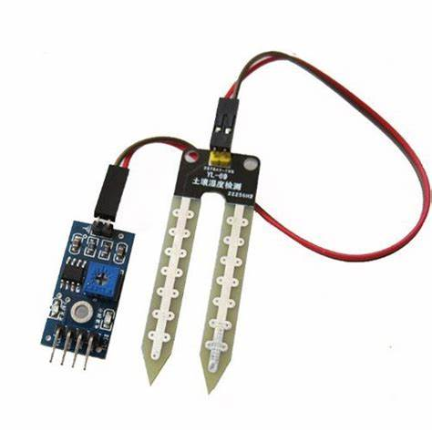
Soil Moisture Sensor

Slide 8
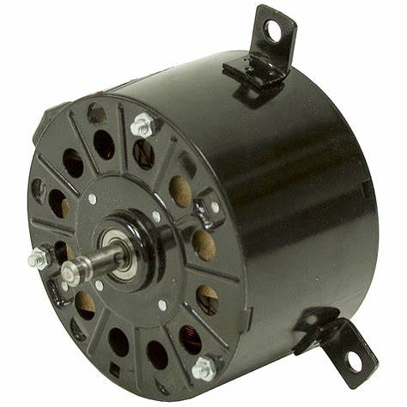
DC Motor

Slide 9
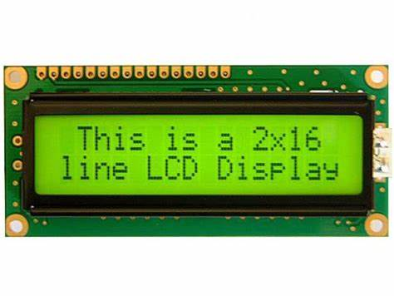
LCD Display

Slide 10
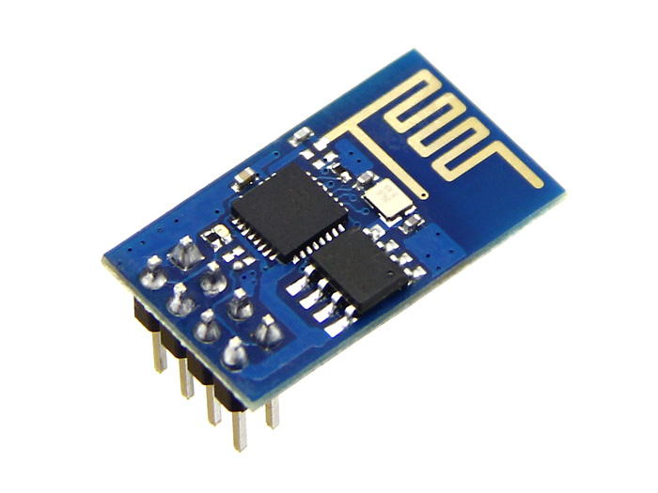
Wifi-Module

Slide 11
PROGRAM
#include <LiquidCrystal.h>
#include "dht.h"
#define dht_apin A1 // Analog Pin sensor is connected to
dht DHT;
#include <SoftwareSerial.h>
String agAdi = "Hotspot kavala mawa"; // We write the name of our network here.
String agSifresi = "password ledhu"; // We write the password of our network here.
int rxPin = 9; //ESP8266 RX pini
int txPin = 10; //ESP8266 TX pini
String ip = "184.106.153.149"; //Thingspeak ip adresi
SoftwareSerial esp(rxPin, txPin); // We make serial communication pin settings.
int ms=A0;
int trig=A2;
int echo=A3;
int motor=A4;
int ii=0;
const int rs = 12, en = 11, d4 = 5, d5 = 4, d6 = 3, d7 = 2;
LiquidCrystal lcd(rs, en, d4, d5, d6, d7);

Slide 12
Continue….
void setup() {
pinMode(trig,OUTPUT);
pinMode(motor,OUTPUT);
pinMode(echo,INPUT);
lcd.begin(16, 2);
lcd.print(" WELCOME");
lcd.setCursor(0,1);
lcd.print("PLANT MONITORING SYS");
esp.begin(115200); // We are starting serial communication with ESP8266.
esp.println("AT"); // We do the module control with the AT command.
Serial.println("AT sent ");
delay(1000);
Serial.println("OK Command Received");
esp.println("AT+CWMODE=1"); // We set the ESP8266 module as a client.
delay(1000);
Serial.println("Set as client");
Serial.println("Connecting to the Network ...");
esp.println("AT+CWJAP=\""+agAdi+"\",\""+agSifresi+"\""); // We are connecting to our network.
delay(1000); // We wait until it is connected to the network.
Serial.println("connected to the network.");
delay(1000);
delay(2000);
}

Slide 13
Continue….
void loop() {
DHT.read11(dht_apin);
int h=DHT.humidity;
int t=DHT.temperature;
int mv=100-analogRead(ms)/10.23;
digitalWrite(trig,1);
delayMicroseconds(10);
digitalWrite(trig,0);
int dist=pulseIn(echo,1)/58.2;
lcd.clear();
lcd.print("T:" + String(t) + " H:"+ String(h));
lcd.setCursor(0,1);
lcd.print("L:" + String(dist) + " M:"+ String(mv));
delay(1000);
if(mv<30)
{
digitalWrite(motor,1);
}
else
{
digitalWrite(motor,0);
}
ii=ii+1;
if(ii>15)
{
ii=0;
esp.println("AT+CIPSTART=\"TCP\",\""+ip+"\",80"); // We connect to Thingspeak.
delay(1000);

Slide 14
Continue…
String veri = "GET https://api.thingspeak.com/update?api_key=R48L3Z3LG4DN0UGX"; // Thingspeak command. We write our own api key in the key part.
veri += "&field1=";
veri += String(t);// The temperature variable we will send
veri += "&field2=";
veri += String(h);// The moisture variable we will send
veri += "&field3=";
veri += String(dist);// The moisture variable we will send
veri += "&field4=";
veri += String(mv);// The moisture variable we will send
veri += "\r\n\r\n";
esp.print("AT+CIPSEND="); // We give the length of data that we will send to ESP.
esp.println(veri.length()+2);
delay(2000);
// The commands in it are running when ESP8266 is ready..
esp.print(veri); // We send the data.
Serial.println(veri);
Serial.println("Data sent.");
delay(1000);
Serial.println("Connection Closed.");
esp.println("AT+CIPCLOSE"); // we close the link
delay(1000);
}
}

Slide 15
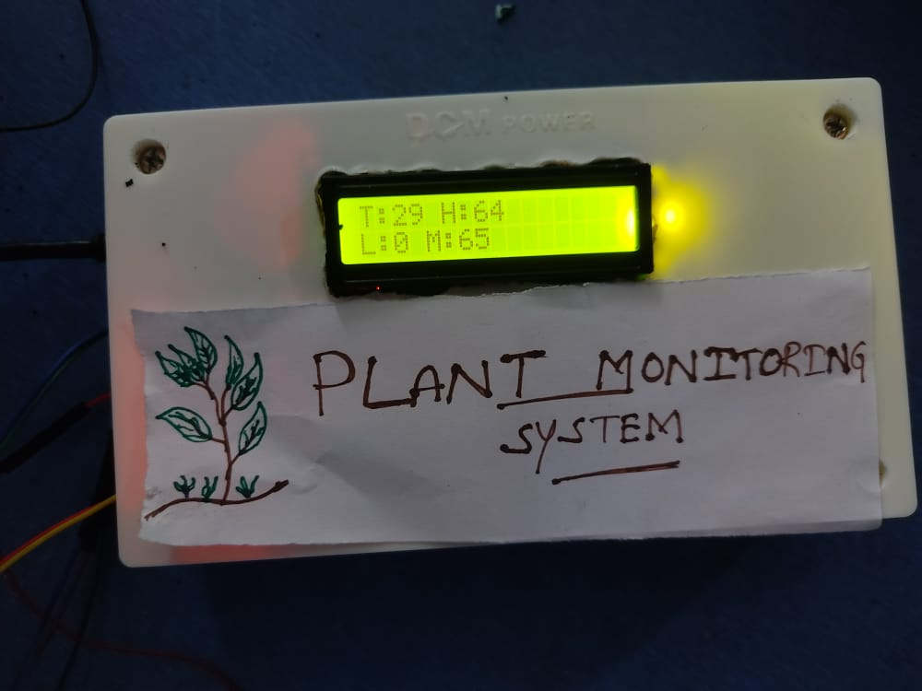
Finally…..🌿🌿🌿

Slide 16
Conclusion 🌱
There has been proposed a new automatic monitoring of plants by creating algorithm for farms at indoor scenarios that is based for restricted crops.
It can effectively used for a particular area and controlled by electronic gadgets. The approach achieving by Soil Moisture sensor which similar to above will operate like above sensor apart from that shows the temperature and Humidity will be going to work.
In future we can add a camera at the field which helps in capturing image and the image can be transmitted to the farmer by connecting the entire system to IOT the image can be observed from anywhere by connecting to the internet.
The farmer can control the operation of motors and heater by considering the soil moisture sensor output.

Slide 17
THANK YOU 💐
Department Of AI & DS (BATCH-8)
ADITYA PINNIKA
NITHIN REDDY CHEERAPUREDDY
BRAHMANANDHA REDDY UPPARAPALLI
SURENDRA KUMAR CHALLA
VILSON BABU PODHILA

